Slide 1
Poisson Regression
Statistical Data Analysis, 2023

Slide 2
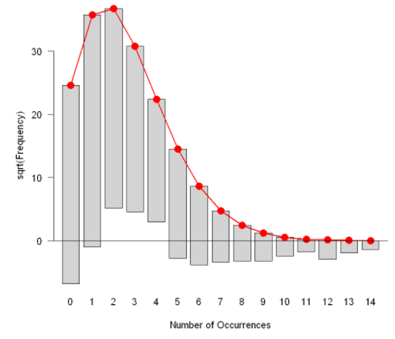
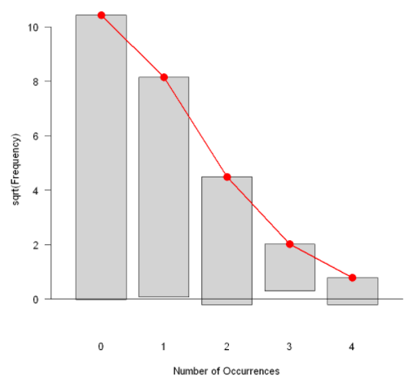

Motivation
Count data appear everywhere
No. of accidents/crimes in a certain period
No. of shared bike users in a certain period
No. of people in front of you in the queue (in a canteen, in a service center, …)
No. of books that a person read in a year
…
In some cases they follow a Poisson distribution
In some cases, a Poisson does not fit well
No. of dependencies in R packages
Death by horse kick in the Prussian army
Rootogram:
(Red: fitted Poisson)

Slide 3
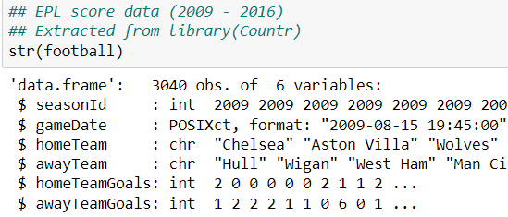


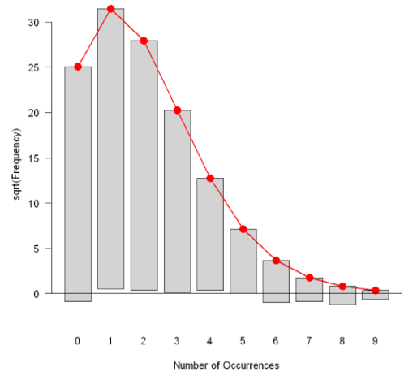
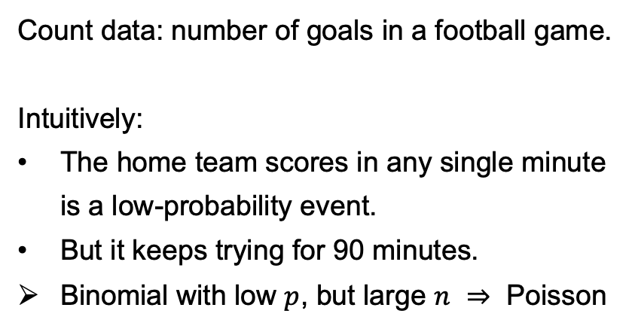
Motivation — Two more interesting examples
Count data: number of goals in a football game.
Intuitively:
The home team scores in any single minute is a low-probability event.
But it keeps trying for 90 minutes.
Binomial with low $p$, but large $n$ $⇒$ Poisson
Rootogram by R function:
goodfit() from library(vcd)

Slide 4


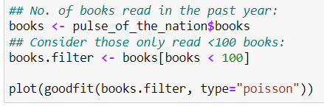
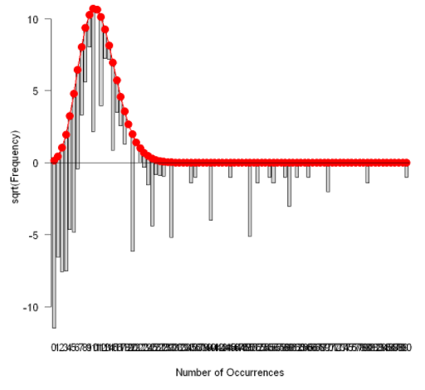
Motivation — Two more interesting examples
Data: number of books read in a year
Observation:
Poisson is a bad fit.
Many people only read a few books or did not read in the past year…

Slide 5
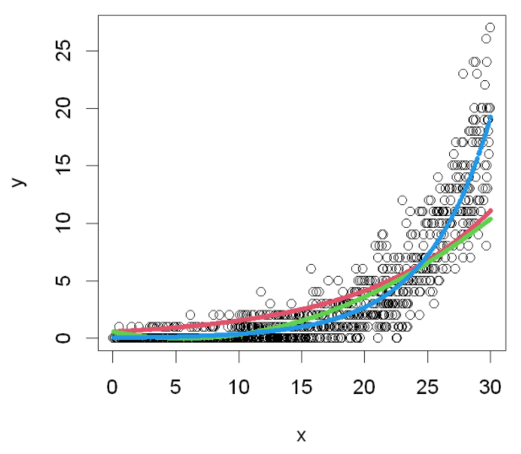
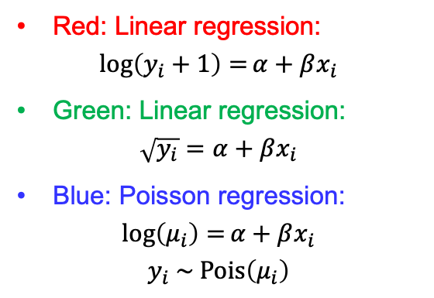
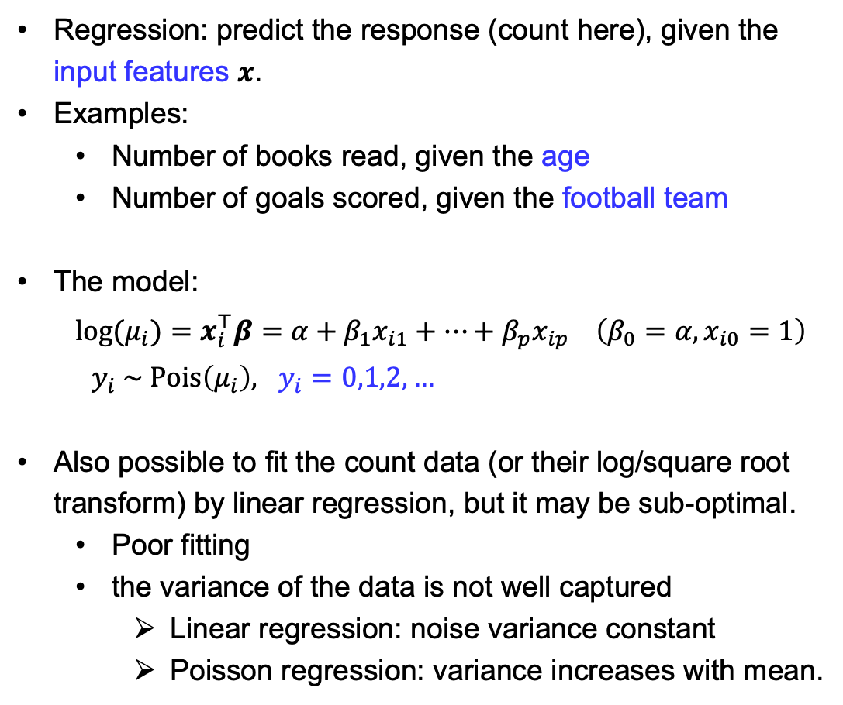
Poisson Regression
Regression: predict the response (count here), given the input features $x$.
Examples:
Number of books read, given the age
Number of goals scored, given the football team
The model:
$\log{(μ_{i})}=x_{i}^{⊤}β=α+β_{1}x_{i1}+…+β_{p}x_{ip} \left(β_{0}=α, x_{i0}=1\right)$
$y_{i} \sim Pois\left(μ_{i}\right), y_{i}=0,1,2,…$
Also possible to fit the count data (or their log/square root transform) by linear regression, but it may be sub-optimal.
Poor fitting
the variance of the data is not well captured
Linear regression: noise variance constant
Poisson regression: variance increases with mean.
Red: Linear regression:
$$\log\left(y_{i}+1\right)=α+βx_{i}$$
Green: Linear regression:
$$\sqrt{y_{i}}=α+βx_{i}$$
Blue: Poisson regression:
$$\log\left(μ_{i}\right)=α+βx_{i}$$
$$y_{i} \sim Pois\left(μ_{i}\right)$$

Slide 6
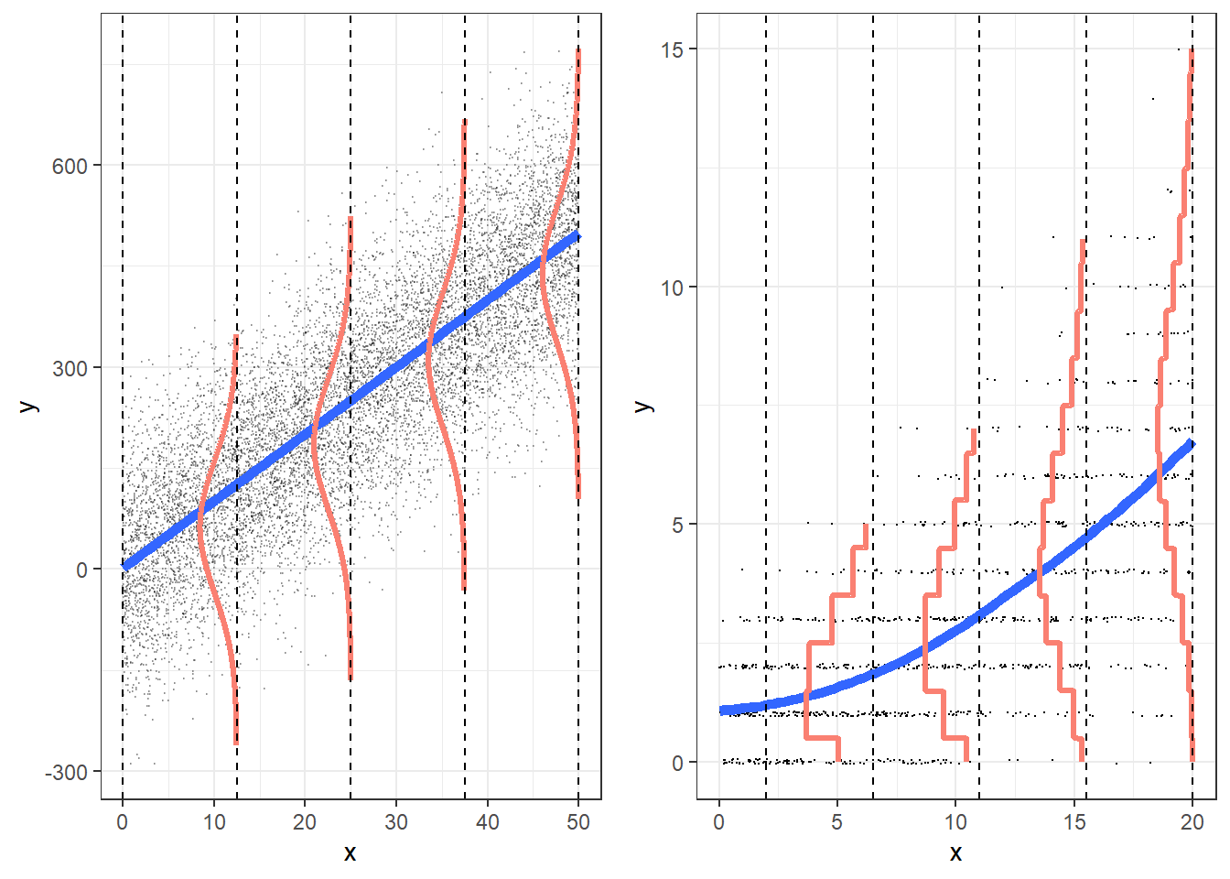
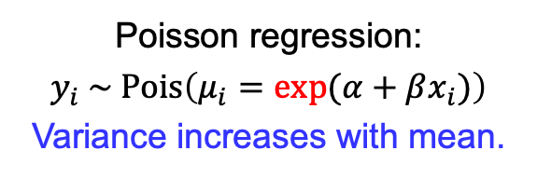
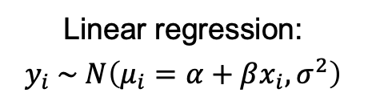
Poisson Regression
Comparison to linear regression
(Poisson is more nature to model count data.)
Linear regression:
$$y_{i} \sim N\left(μ_{i}=α+βx_{i},σ^{2}\right)$$
Poisson regression:
$$y_{i} \sim Pois\left(μ_{i}=\exp{(α+βx_{i})}\right)$$
Variance increases with mean.
Notes:
Linear regression: noise variance constant.
Poisson regression: variance increase with mean (a typical feature of count data)

Slide 7
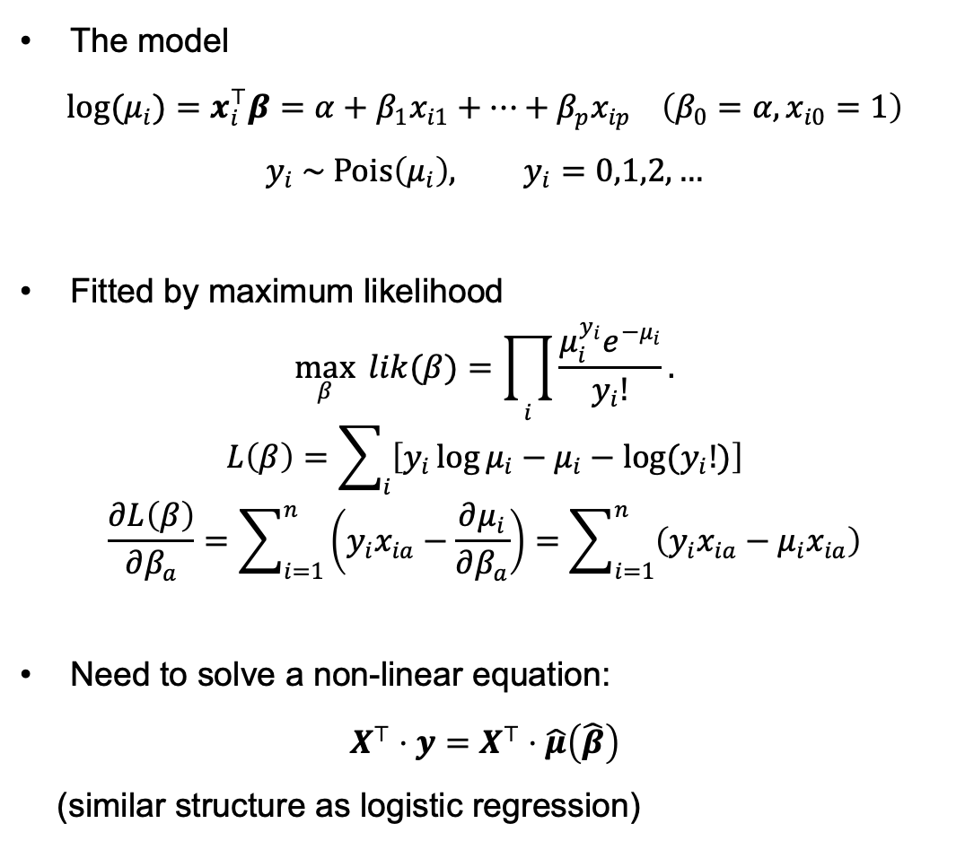
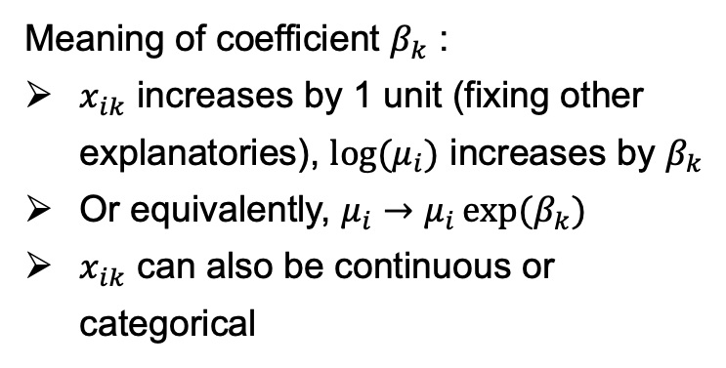
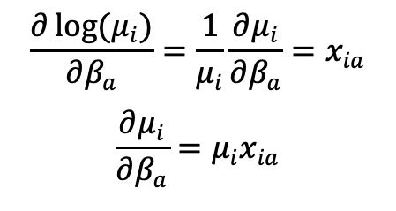
Poisson Regression — Fitting (Optional)
The model
$$\log{(μ_{i})}=x_{i}^{⊤}β=α+β_{1}x_{i1}+…+β_{p}x_{ip} \left(β_{0}=α, x_{i0}=1\right)$$
$$y_{i} \sim Pois\left(μ_{i}\right), y_{i}=0,1,2,…$$
Fitted by maximum likelihood
$$\max_{β}{ lik(β)}=\prod_{i}{\frac{μ_{i}^{y_{i}}e^{−μ_{i}}}{y_{i}!}}.$$
$$L\left(β\right)=\sum_{i}{\left[y_{i}\log{μ_{i}}−μ_{i}−\log{(y_{i}!)}\right]}$$
$$\frac{∂L\left(β\right)}{∂β_{a}}=\sum_{i=1}^{n}{\left(y_{i}x_{ia}−\frac{∂μ_{i}}{∂β_{a}}\right)}=\sum_{i=1}^{n}{\left(y_{i}x_{ia}−μ_{i}x_{ia}\right)}$$
Need to solve a non-linear equation:
$$X^{⊤}⋅y=X^{⊤}⋅\hat{μ}\left(\hat{β}\right)$$
(similar structure as logistic regression)
Meaning of coefficient $β_{k}$ :
$x_{ik}$ increases by 1 unit (fixing other explanatories), $\log{(μ_{i})}$ increases by $β_{k}$
Or equivalently, $μ_{i}→μ_{i}\exp{{(β}_{k})}$
$x_{ik}$ can also be continuous or categorical
$$\frac{∂\log{(μ_{i})}}{∂β_{a}}=\frac{1}{μ_{i}}\frac{∂μ_{i}}{∂β_{a}}=x_{ia}$$
$$\frac{∂μ_{i}}{∂β_{a}}=μ_{i}x_{ia}$$

Slide 8
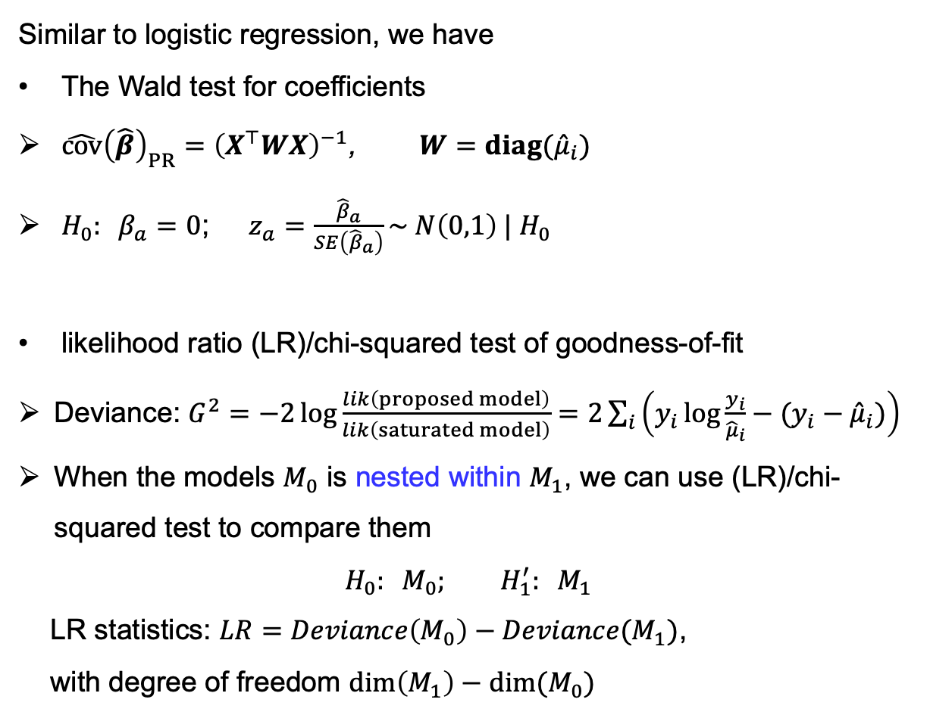
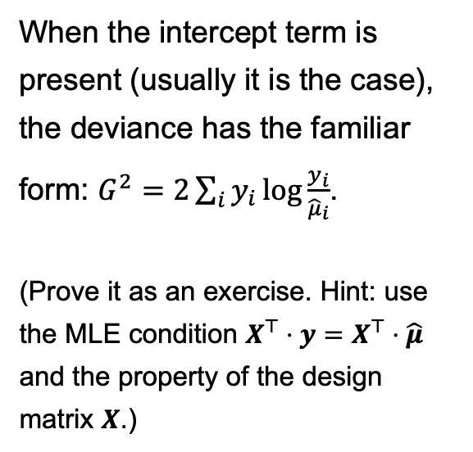
Poisson Regression — Statistical inference (Optional)
Similar to logistic regression, we have
The Wald test for coefficients
$\hat{cov}{\left(\hat{β}\right)}_{PR}={\left(X^{⊤}WX\right)}^{−1}$, $W=diag({\hat{μ}}_{i})$
$H_{0}: β_{a}=0$; $z_{a}=\frac{{\hat{β}}_{a}}{SE\left({\hat{β}}_{a}\right)}\sim N\left(0,1\right) | H_{0}$
likelihood ratio (LR)/chi-squared test of goodness-of-fit
Deviance: $G^{2}=−2\log{\frac{lik\left(proposed model\right)}{lik\left(saturated model\right)}}=2\sum_{i}{\left(y_{i}\log{\frac{y_{i}}{{\hat{μ}}_{i}}}−(y_{i}−{\hat{μ}}_{i})\right)}$
When the models $M_{0}$ is nested within $M_{1}$, we can use (LR)/chi-squared test to compare them
$$H_{0}: M_{0}; H_{1}^{′}: M_{1}$$
LR statistics: $LR=Deviance\left(M_{0}\right)−Deviance(M_{1})$,
with degree of freedom $dim\left(M_{1}\right)−dim(M_{0})$
When the intercept term is present (usually it is the case), the deviance has the familiar form: $G^{2}=2\sum_{i}{y_{i}\log{\frac{y_{i}}{{\hat{μ}}_{i}}}}$.
(Prove it as an exercise. Hint: use the MLE condition $X^{⊤}⋅y=X^{⊤}⋅\hat{μ}$ and the property of the design matrix $X$.)
Notes:
We have used the LR test in the special case of log-linear model.
Compare the saturated: goodness-of-fit in terms of describing the data.

Slide 9
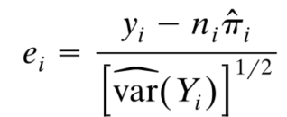
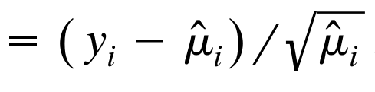
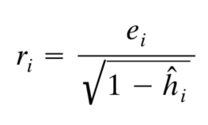
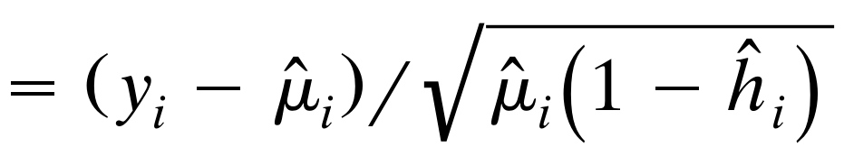
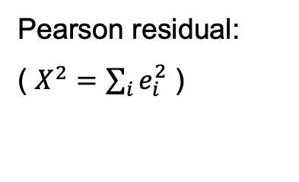
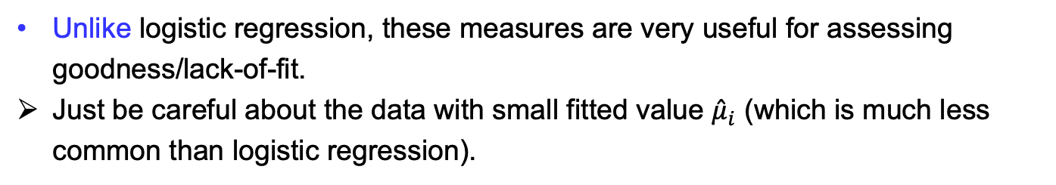
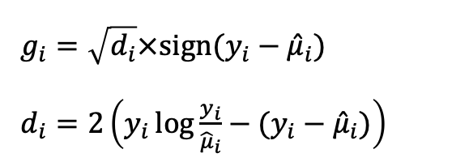
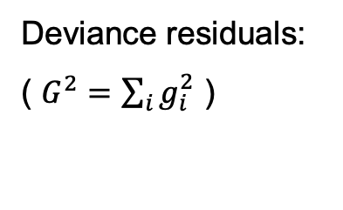
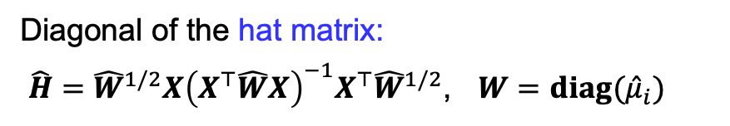
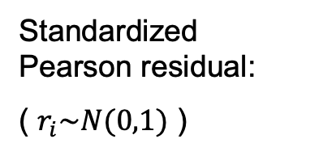
Poisson Regression — Local lack-of-fit
Pearson residual:
( $X^{2}=\sum_{i}{e_{i}^{2}}$ )
Standardized Pearson residual:
( $r_{i}\sim N(0,1)$ )
Diagonal of the hat matrix:
$\hat{H}={\hat{W}}^{1/2}X{\left(X^{⊤}\hat{W}X\right)}^{−1}X^{⊤}{\hat{W}}^{1/2}$, $W=diag({\hat{μ}}_{i})$
$g_{i}=\sqrt{d_{i}}×sign(y_{i}−{\hat{μ}}_{i})$
$d_{i}=2\left(y_{i}\log{\frac{y_{i}}{{\hat{μ}}_{i}}}−(y_{i}−{\hat{μ}}_{i})\right)$
Deviance residuals:
( $G^{2}=\sum_{i}{g_{i}^{2}}$ )
Unlike logistic regression, these measures are very useful for assessing goodness/lack-of-fit.
Just be careful about the data with small fitted value ${\hat{μ}}_{i}$ (which is much less common than logistic regression).

Slide 10
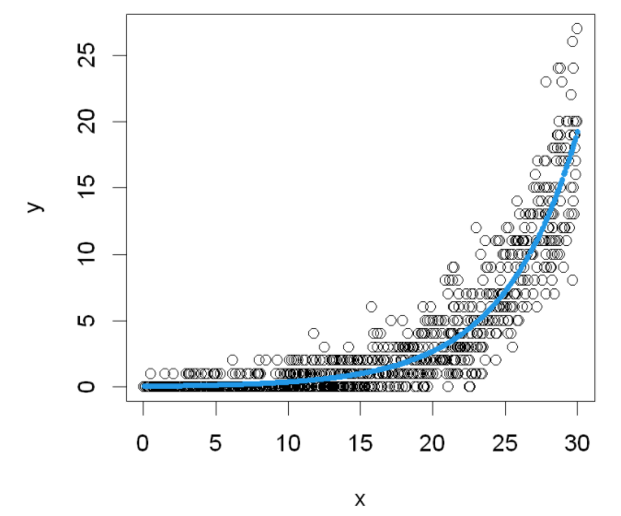
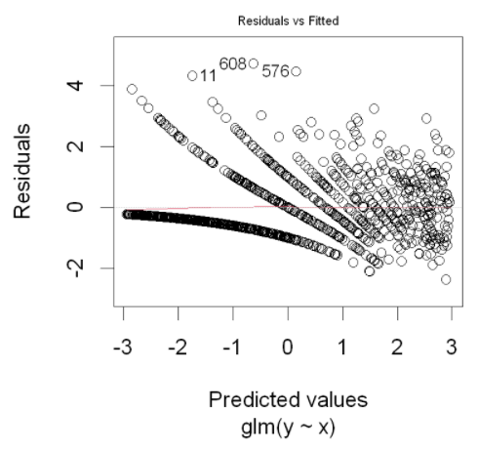
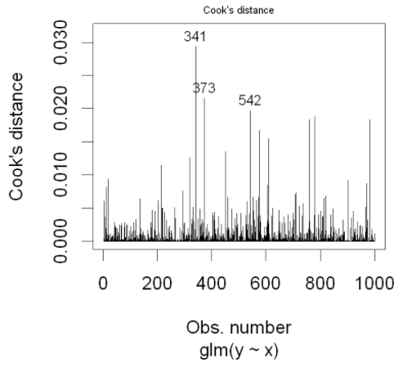
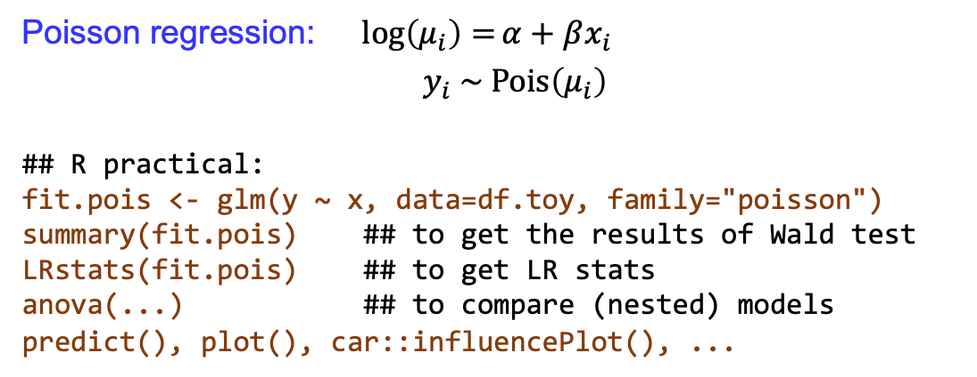
Poisson Regression — A toy example
Poisson regression: $\log\left(μ_{i}\right)=α+βx_{i}$
$y_{i} \sim Pois\left(μ_{i}\right)$
## R practical:
fit.pois <- glm(y ~ x, data=df.toy, family="poisson")
summary(fit.pois) ## to get the results of Wald test
LRstats(fit.pois) ## to get LR stats
anova(...) ## to compare (nested) models
predict(), plot(), car::influencePlot(), ...
Some basic diagnostics:
Notes:
The discrete non-linear curves are common for count data.

Slide 11
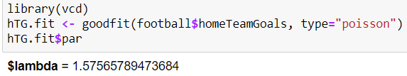
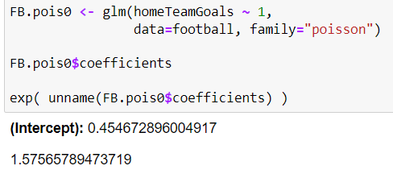
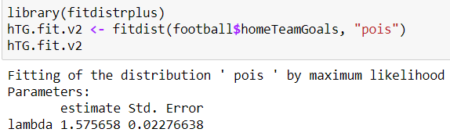
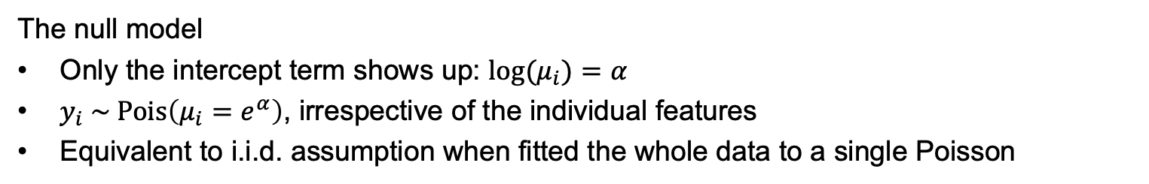
Poisson Regression — The null model
The null model
Only the intercept term shows up: $\log{(μ_{i})}=α$
$y_{i} \sim Pois\left(μ_{i}=e^{α}\right)$, irrespective of the individual features
Equivalent to i.i.d. assumption when fitted the whole data to a single Poisson
Football data as an example:
In the case where the null model works well, we can also introduce further features to improve the fitting!!

Slide 12
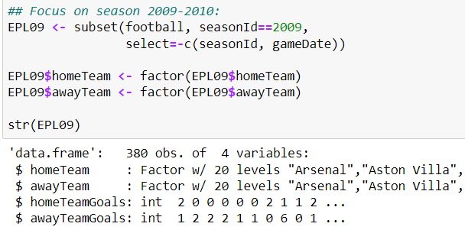
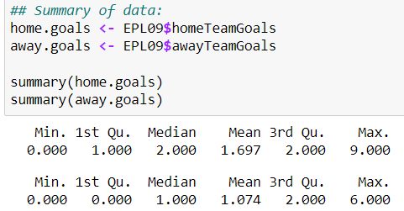

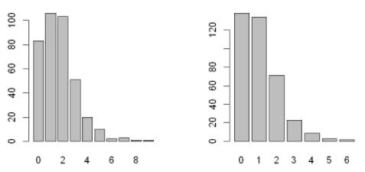
Example — EPL home goals
Observations:
Home teams seem to have some advantage.
These overall features do not tell us which teams play better/worse.
Let's build a model to describe their performance and predict their no. of goals !!
Notes:
Compare median goals.
Away team has a higher chance of no goals.

Slide 13
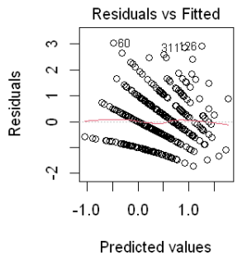
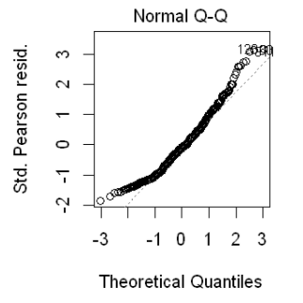
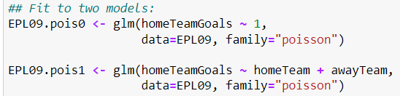
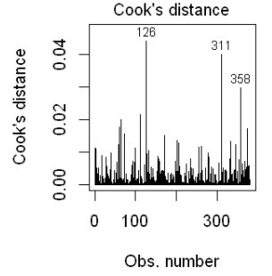
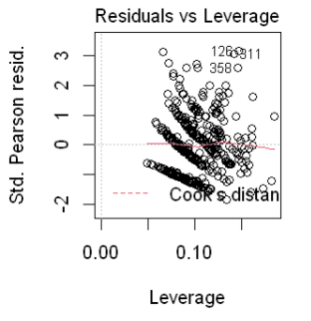
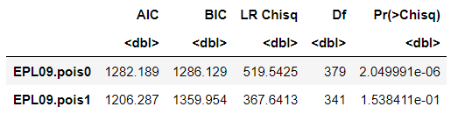
Example — EPL home goals
Modeling elements:
For simplicity, let's try to predict the home team goals.
The home team and its opponent are the most important features (the stronger the home team, the weaker the away team, the more goals)
The residuals and Cook's distance do not show abnormal behaviors.
The are a few matches which are more influential.
Knowing which two teams played provides a much better global fit.

Slide 14


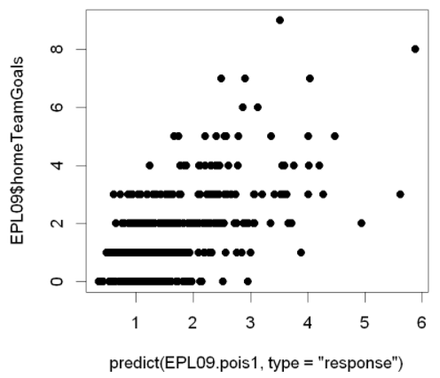
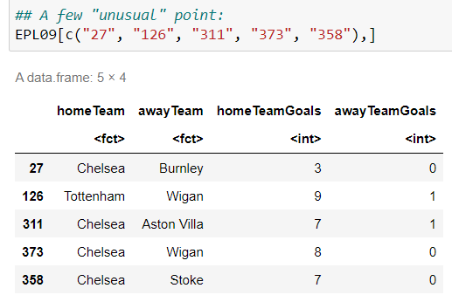
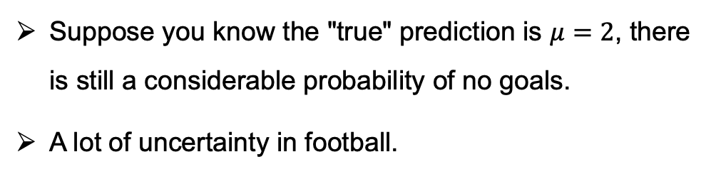
Example — EPL home goals
Suppose you know the "true" prediction is $μ=2$, there is still a considerable probability of no goals.
A lot of uncertainty in football.
Do you consider the prediction good or not good ?

Slide 15
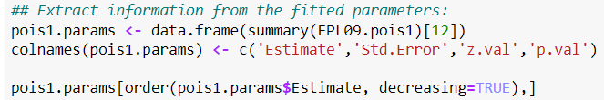
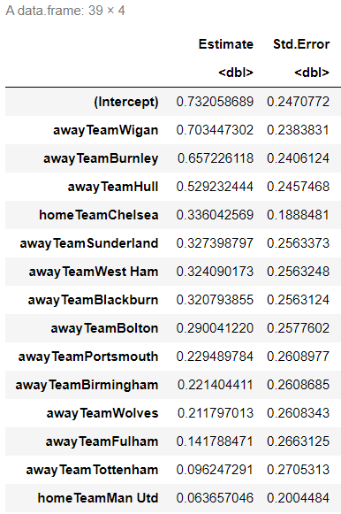



Example — EPL home goals
Remind
Dummy coding is used in glm
Coefficients of Arsenal (first level) is coded as zero.
EPL 2009/10 Standings:
Observations
The effect of weak away teams to be conceded is very strong…
Chelsea (the final champion) excelled at home.
The parameters are associated with performance.
Notes:
Weak teams can lose goals to either strong teams or weak teams…
So their effects are stronger than strong team to score.

Slide 16











Example — EPL home goals
The result looks good, but can we do better ?
In fact, only half information of the data was used.
We can model the interplay between the home team and away team, to predict homeTeamGoals and awayTeamGoals simultaneously !!
A popular double Poisson model:
$y_{1i} \sim Pois\left(λ_{1i}\right)$ (home team goals)
$y_{2i} \sim Pois\left(λ_{2i}\right)$ (away team goals)
$$home$$
$${att}_{h_{i}}$$
$$def_{g_{i}}$$
$${att}_{g_{i}}$$
$$def_{h_{i}}$$
See the R package footBayes and the references therein for different modeling approaches:
https://cran.r-project.org/web/packages/footBayes/index.html
Another interesting problem is to compare the team performance across seasons.
$$λ_{1i}$$
$$λ_{2i}$$
$$y_{1i}$$
$$y_{1i}$$

Slide 17


Poisson Regression — Overdispersion
It is possible that even after considering the available explanatories, a Poisson regression still does not fit well.
This is possible if
there are unobserved explanatories.
the assumptions of Poisson regression fail.
In practice, the Poisson model typically underestimates the variance in the data. This is called overdispersion.
To further study this phenomenon, let's look into another interesting example.
Poisson regression
$$y_{i}|x_{i} \sim Pois\left(μ_{i}=\exp{(x_{i}^{⊤}β\text{)}}\right)$$
assumes that for a given explanatory $x_{i}$, the parameter $μ_{i}$ for generating $y_{i}$ is a constant.
No. of dependencies in R packages

Slide 18





Example — PhD Publication
Long (1990, 1997) gave data on the number of publications by 915 doctoral candidates in bio-chemistry in the last three years of their PhD studies. The data set also includes information on gender, marital status, number of young children, prestige of the doctoral department, and number of publications by the student's mentor.

Slide 19



Example — PhD Publication
Initially, ignore the predictors. For the Poisson:
this corresponds to an intercept-only model:
glm(articles ~ 1, data=PhdPubs, family=poisson)
Or view the no. of articles published as i.i.d. Poisson:
The fitting is poor; one reason is the excess 0s (some never published)
Overdispersion is observed.
Let's try to add explanatories.

Slide 20




Example — PhD Publication — Poisson regression
phd.pois1 is much better than phd.pois0
Including all the interaction terms, phd.pois2 (surprisingly) does not make much improvement over phd.pois1

Slide 21


Example — PhD Publication — Effects
Since phd.pois1 is much simpler, let's focus on it.
Having an additional child results in less publications
The effect of PhD prestige is not so significant
Publications of mentors have a strong effect
…
Be careful if you are tempted to consider them as causal effects...
Notes:
Possible association in the data:
Female, married and number of young children.

Slide 22




Example — PhD Publication — Diagnostics
Some data with large residuals and/or leverage.
?

Slide 23



Example — PhD Publication — Detecting overdispersion (heuristic)
For a Poisson regression model, its chi-squared statistics $X^{2}$ has degrees of freedom $df=\# observations −\# unique model parameters$
if the model holds, it is expected that $X^{2}\sim χ^{2}(df)$ and $E\left(X^{2}\right)=df$.
A heuristic rule: if $X^{2}/df>1$, there is some overdispersion
this require you to be confident that all important explanatories and modeling elements are taking into account
We have seen that the lack-of-fit is not due to neglecting interactions:
(Q: lack of fit due to nonlinear relation?)

Slide 24



Example — PhD Publication — Detecting overdispersion (test)
Alternatively, we can test the null hypothesis of Poisson variation
$$H_{0}:Var\left(y\right)=μ$$
against an alternative that the variance has a particular form depending on the mean
$$H_{1}:Var\left(y\right)=μ+α×f(μ)$$
Common specifications of the function $f(μ)$ are $f\left(μ\right)=μ$, $f\left(μ\right)=μ^{2}$
In R, it is implemented in dispersiontest() in the AER package

Slide 25


Models to handle overdispersion (Optional)
Quasi-Poisson model
Conditional variance as: $Var\left(y_{i} | x_{i}^{⊤}β\right)=φμ_{i}$
Negative-binomial model
Conditional variance as: $Var\left(y_{i} | x_{i}^{⊤}β\right)=μ_{i}+μ_{i}^{2}/k$
When zero counts are believed to be the main issues
Zero-inflated models
With a logit model to predict the zeros
hurdle (or zero-altered) models
Some hurdle to overcome before attaining a positive count
PhD publications

Slide 26

Negative-binomial model — Motivation
In Poisson models $y_{i}\sim Pois(μ_{i})$, the parameter $μ_{i}$ is considered as a constant
$μ_{i}=\exp\left(x_{i}^{⊤}β\right)$
We can model the extra variability by allowing it to be a random variable (due to intrinsic stochasticity or unobserved effects)
${\tilde{μ}}_{i}=μ_{i}ε_{i}=\exp\left(x_{i}^{⊤}β\right)ε_{i}$ ($ε_{i}>0$ is an unobserved random variable)
A Gamma distribution is usually assumed for $ε_{i}$ (for mathematical convenience), with
$E\left(ε_{i}\right)=1, Var\left(ε_{i}\right)=1/k$ ($k>0$ is a tuning parameter)
Integrating out the noise $ε_{i}$, the unconditional distribution of the outcome follows a negative binomial distribution
$$P\left(y_{i} | μ_{i},k\right)=\int_{0}^{∞}{Pois\left(y_{i}|λ=μ_{i}ε_{i}\right)}×Gamma\left(ε_{i} | α=β=k\right)dε_{i}=NegBin\left(y_{i} | μ_{i},k\right),$$
$$E\left(y_{i}\right)=μ_{i}, Var\left(y_{i}\right)=μ_{i}+\frac{μ_{i}^{2}}{k}.$$
Notes:
Also can be check by the law of total variance.

Slide 27




Negative-binomial model — The distribution
Marginally, the Gamma mixture of the Poisson yields the negative binomial.
The probability mass function of negative binomial distribution:
(There are other parametrizations.)
The smaller $k$, the greater the overdispersion compared to the ordinary Poisson.
More flexible than Poisson (with an additional parameter).
Another source of negative binomial:
If $k$ is an integer, the distribution of the number of successes up to the $k$-th failure in a sequence of independent Bernoulli trials with probability of success $p=m/(m+k)$ is negative binomial.
Notes:
Fail k times ( prob = k/(mu+k) ), success y times ( prob = mu/(mu+k) )

Slide 28





Negative-binomial model — The distribution
No. of dependencies in R packages
Rootogram:
(Red: fitted negative binomial)
Mixture of Poisson
PhD publications
We can also introduce explanatories:
Negative-binomial regression

Slide 29



Example — PhD Publication — Negative binomial regression
For fixed $k$, the negative-binomial is another special case of the GLM.
In R, this is handled in the MASS package, with family=negative.binomial(theta) (the parameter $k$ is called theta).
But most often, $k$ is unknown, and must be estimated from the data.
This is implemented in glm.nb() in the MASS package.
Observations
Negative binomial regression provides a much better fitting.
The effects are very similar to Poisson regression (not shown).
Subject to some influential observations, similar as Poisson.

Slide 30




Zero Inflated Models
zero-inflated models: a latent class type model
$$P_{z}\left(y_{i} | x_{i}\right)=\left\{\begin{aligned}π_{i}+\left(1−π_{i}\right)P(0|x_{i}) \\ \left(1−π_{i}\right)P(y_{i}|x_{i})\end{aligned}\right.$$
If $P\left(y_{i} | x_{i}\right)$ is a Poisson distribution with a log link, the model is called a zero inflated Poisson (ZIP).
$E\left(y_{i}\right)=$ $\left(1−π_{i}\right)μ_{i}$
$Var\left(y_{i}\right)=\left(1−π_{i}\right)μ_{i}\left(1+μ_{i}π_{i}\right)$
Similarly, we can construct a zero-inflated negative-binomial model.
The unobserved (latent) class of zero is usually modelled by a logistic regression:
$$logit\left(π_{i}\right)=z_{i}^{⊤}γ$$
Other cases with excess zeros
Zero publications (research ideas not working?)
Zero books read (too busy? no reading habit?)
…
Worthwhile to model these.
The parameter $γ$ may explains the effect of excess zeros.
Notes:
If negative binomial is working well, why need zero inflated models?

Slide 31


Example — PhD Publication — ZIP
In R, use zeroinfl() from library(pscl) for fitting to ZIP.
Observations
More parameters are needed for ZIP (more complex).
The overall fitting is not as good as negative binomial regression (not shown here). But the model has the potential to explain the "non-publishers".
Only mentor is significant for the latent zero (logit) model !
Further development of the model:
See [Discrete Data Analysis with R — Friendly and Meyer]
Notes:
Options:
(1) zero inflated Poisson or zero inflated negative binomials
(2) whether the zero model should use all predictors or only a subset
(3) Interactions

